Slide 1
Laws and Ethics CS-4440 - Introduction to Computer Security
Spring 2022
Jun Xu
Some slides adapted from Stephen Checkoway’s CS487 at University of Illinois Chicago

Slide 2
I love teaching this course, but I am always a bit concerned
You can do bad things with knowledge/skills/techniques learned from this course

Slide 3
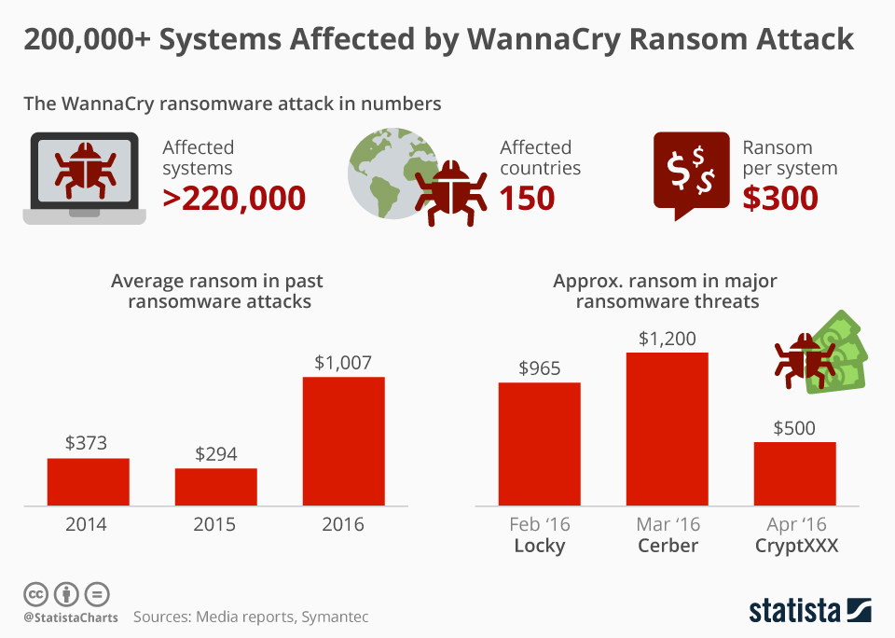
Reversing WannaCry: https://www.youtube.com/watch?v=Sv8yu12y5zM&list=PLniOzp3l9V83Yf52IXJTvW9rjstdqkduP&ab_channel=stacksmashing
Notes:
WannaCry

Slide 4
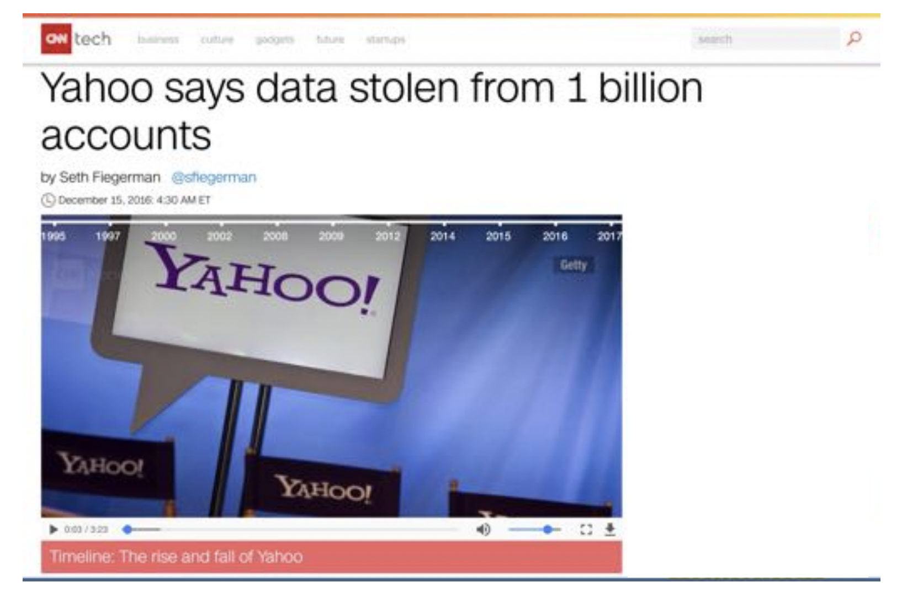
Notes:
Yahoo now believes an "unauthorized third party" stole user data from more than one billion accounts in August 2013. That data may have included names, email addresses and passwords, but not financial information.
The company will notify users who may be affected and has begun requiring users to change their passwords.
The security incident, likely one of the largest cybersecurity breaches ever, comes less than three months after Yahoo admitted data from at least 500 million accounts had been stolen.

Slide 5
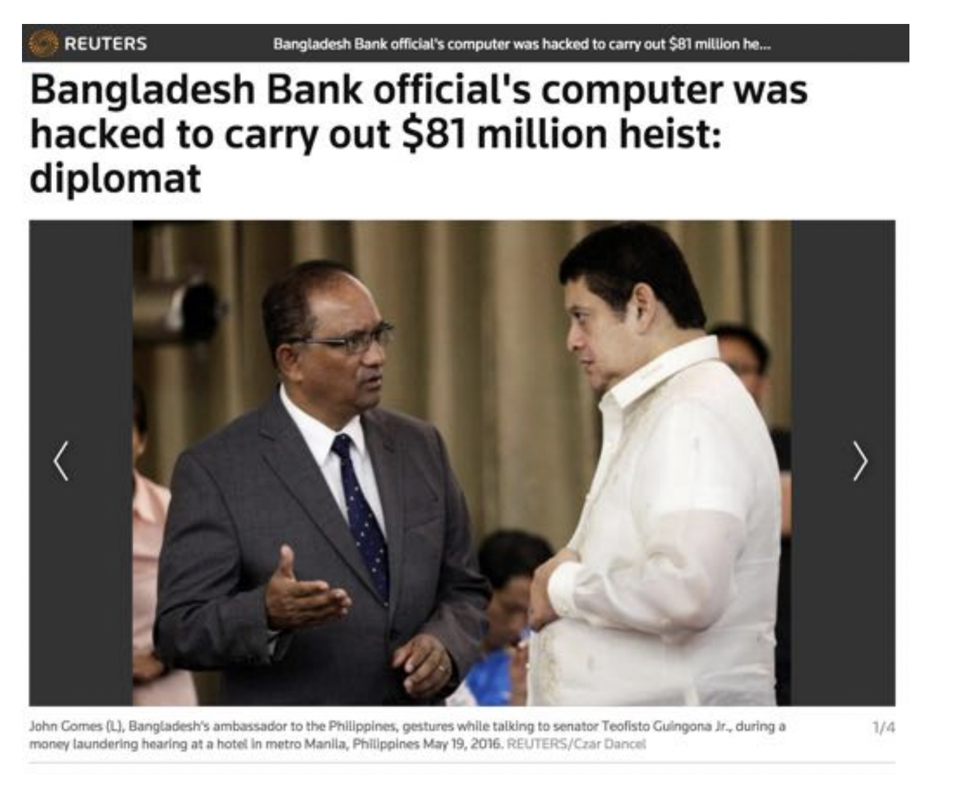
Notes:
MANILA (Reuters) - A Bangladeshi central bank official’s computer was used by unidentified hackers to make payments via SWIFT, and carry out one of the biggest-ever cyber heists, a Bangladeshi diplomat said on Thursday at the end of a Philippine Senate inquiry.
There were certain indications about who the hackers were, Bangladesh Ambassador John Gomes told a panel looking into how the $81 million in stolen money ended up in the Philippines, citing information shared by the U.S. Federal Bureau of Investigation.

Slide 6
I am not a lawyer, but
Computer Fraud and Abuse Act (CFAA) – "it is illegal to intentionally access a computer without authorization or in excess of authorization and thereby obtaining information from any protecting computer."
Digital Millennium Copyright Act (DMCA) – “No person shall circumvent a technological measure that effectively controls access to [a work protected by copyright law]”
Electronic Communications Privacy Act (ECPA) – Wiretap Act – Pen Register Statute – Stored Communications Act
State and Local Laws – Utah; 76-6-701 Computer Crimes Act
Computers and networks may carry data for a variety of institutions such as hospitals, libraries, universities, and K-12 organizations – Family Educational Right to Privacy Act (FERPA);
Federal Standards for Privacy of Individually Identifiable Health Information (implements the privacy requirements HIPAA)

Slide 7
Contracts and Policies
End User License Agreements (EULA)
Do not criticize this product publicly
Using this product means you will be monitored
Do not reverse-engineer this product
We are not responsible if this product messes up your computer
Organizational Policies
The U: Policy 6-400: Code of Student Rights and Responsibilities (“Student Code”)

Slide 8
Tip
If you are not sure if something is legal, that’s probably not, so better talk to the professionals

Slide 9
I love teaching this course, but I am always a bit concerned
You may think you are doing good things, but that may not be the truth

Slide 10
Computer Ethics
“A typical problem in computer ethics arises because there is a policy vacuum about how computer technology should be used. Computers provide us with new capabilities and these in turn give us new choices for action. Often, either no policies for conduct in these situations exist or existing policies seem inadequate. A central task of computer ethics is to determine what we should do in such cases, i.e., to formulate policies to guide our actions.”
-Moor

Slide 11
Ethics != Law
“Law can be defined as a consistent set of universal rules that are widely published, generally accepted, and usually enforced”
Interrelated but by no means identical (e.g., legal but not ethical, ethical but not legal)

Slide 12
Existing Ethics Standards
1947 Nuremberg Code
Helsinki Declaration 1964
The IEEE, ACM, etc: Codes of Ethics
The Belmont Report, the National Research Act, and Institutional Review Boards (IRB) – 45 CFR 46
“Rules of Engagement” – The Law of Armed Conflict – Dittrich/Himma: Active Response Continuum
Other Organizational Codes (Universities, Corporations, etc.)

Slide 13
IRB and the Belmont report
The primary goal of the Institutional Review Board (IRB) is to assure that, in research involving human subjects, the rights and welfare of the subjects are adequately protected.
"Ethical Principles and Guidelines for the Protection of Human Subjects of Research”, United States Department of Health, Education, and Welfare, April 18, 1979 (Belmont Report)
Respect for persons
– Individuals should be treated autonomously; Informed consent should be freely given
Beneficence
– Do no harm; Maximize possible benefits/minimize risks
Distributive Justice – Equitable selection of research subjects

Slide 14
Professional Ethical Codes
IEEE Code of Ethics (2006)
– commits members ”to the highest ethical and professional conduct”. Members agree to avoid conflicts of interest, be honest, engage in responsible decision making, accept criticism of work, etc
ACM Code of Ethics and Professional conduct (1992)
– “contribute to society and human well-being”, “avoid harm to others”, along with six other principles (e.g., don’t discriminate, be honest, respect privacy).

Slide 15
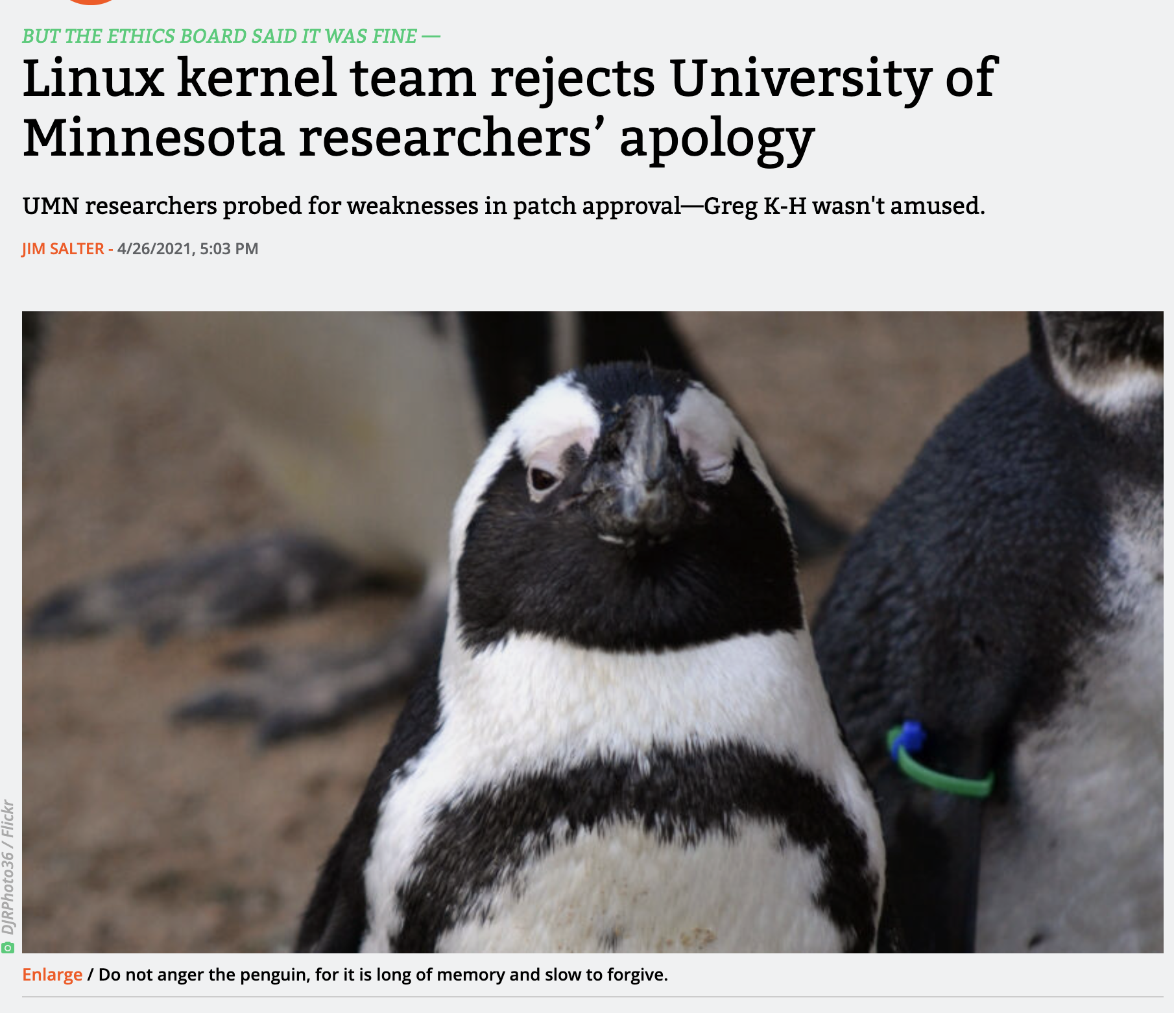

Slide 16
Case Study: Botnets
Botnets, briefly
– Bots are compromised computers under the control of some 3rd party
– Collection of bots comprise a botnet – Bots communicate with command & control servers which provide instructions, e.g., DDOS a host, send spam, find new machines to infect
– (Almost) every major security incident today involves botnets

Slide 17
Case Study: Botnets
A researcher constructs a benign botnet out of compromised routers and uses it to measure the entire Internet; data released publicly and anonymously
Is this ethical?
What are the potential issues?

Slide 18
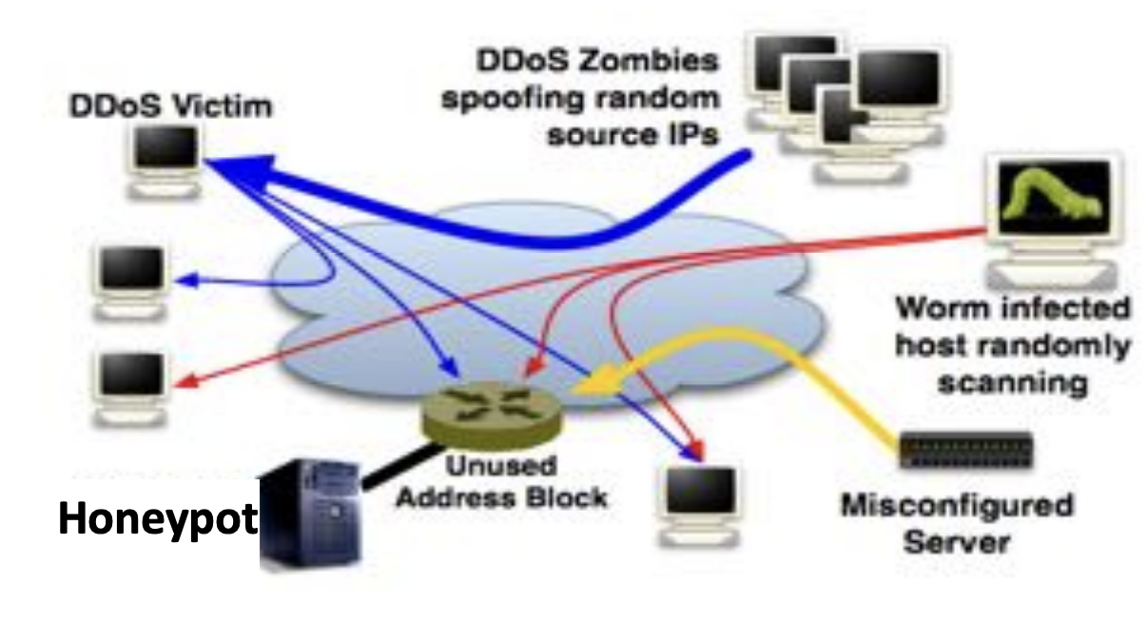
Case Study: Honeypots
Researchers create a research test beds, connected to the Internet, which enables test bed machines to become infected.

Slide 19
Case Study: Honeypots
Why? Capture malware, see exactly what files it creates/modifies/deletes, see its network traffic, find its command and control servers
Is this ethical?
What are potential issues?

Slide 20
Case Study: Hack back
Organizations get hacked all the time. Sometimes the only (feasible) way to identify the attackers or prevent future attacks is to hack back
Is this ethical?
Potential issues?

Slide 21
Case Study: Reverse Engineering, Vulnerability Disclosure?
Researchers reverse engineer a system, discover a vulnerability, and generate a working exploit (attack).
Lots of debate about how and if one should disclose the vulnerability
– Full disclosure: go public immediately
– Give vendor a deadline before disclosure
– Coordinate disclosure with the vendor
– (lots of other options)
https://blog.regehr.org/archives/2037 by John Regehr

Slide 22
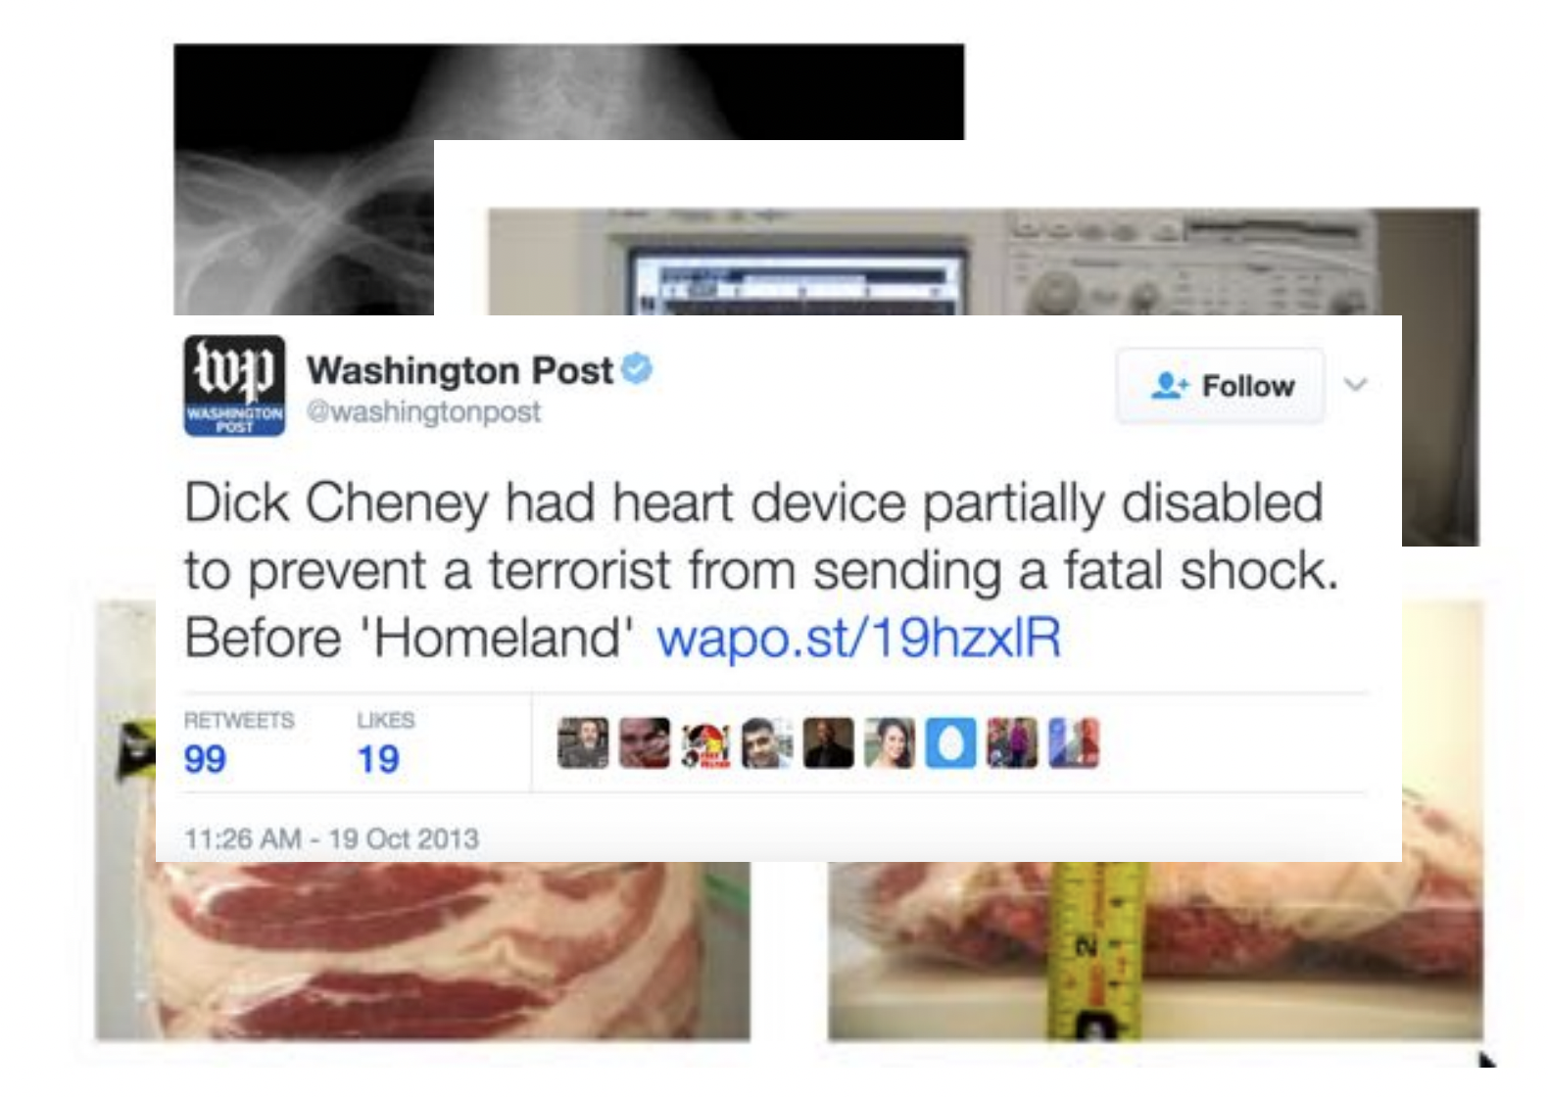

Slide 23
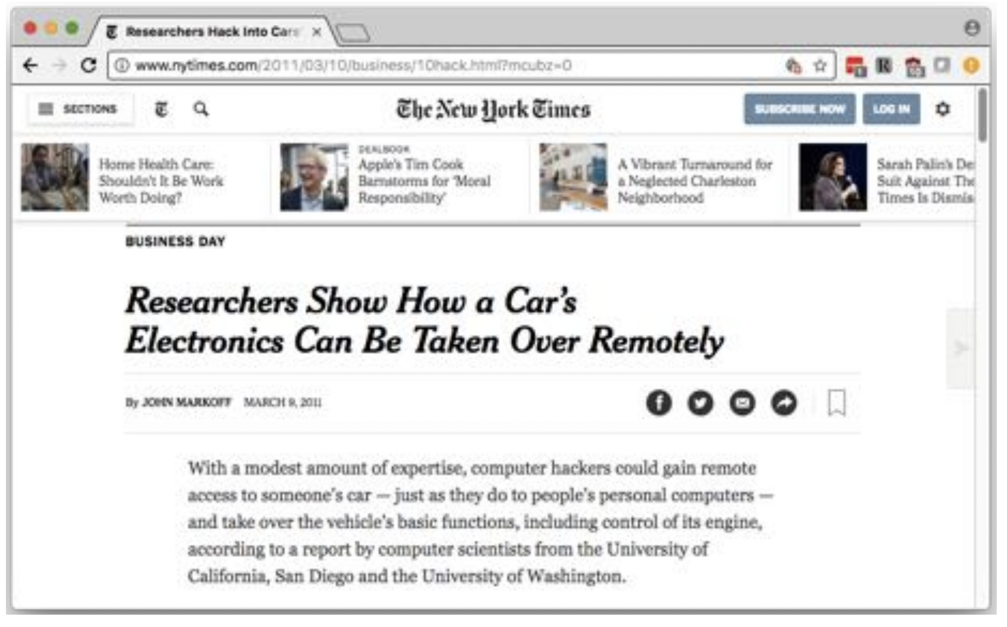

Slide 24
Case Study: Reverse Engineering, Vulnerability Disclosure?
Is this sort of reverse-engineering work ethical?
Potential issues?

Slide 25
Wireless Eavesdropping
A student in class creates a wireless network access point with no encryption or authentication and observes users who connect to it.
Is this ethical?
Potential issues?

Slide 26
In this Course
You will not be asked to do anything that is illegal, unethical, or against university policy, so maybe you shouldn’t
Ask permission not forgiveness
Principle of least surprise

Slide 27
To Learn More
http://www.icir.org/vern/cs261n/papers/burstein_legal_leet.pdf
David Dittrich, Michael Bailey, Sven Dietrich. Building an Active Computer Security Ethics Community.
Dittrich, David and Kenneally, Erin and Bailey, Michael, Applying Ethical Principles to Information and Communication Technology Research: A Companion to the Menlo Report
https://www.acm.org/about/code-of-ethics
http://www.ieee.org/about/corporate/governance/p7-8.html
https://www.eff.org/pages/grey-hat-guide
http://www.cam.illinois.edu/viii/viii-1.1.htm

Slide 28
Prepare for Next Week: Secure Communications
Threats model
You and another person, who are both benign, want to communicate over the network/internet
The potential threats you should consider?
?
?
?

